Slide 1

Analyzing Airline Reviews and ratings

Slide 2
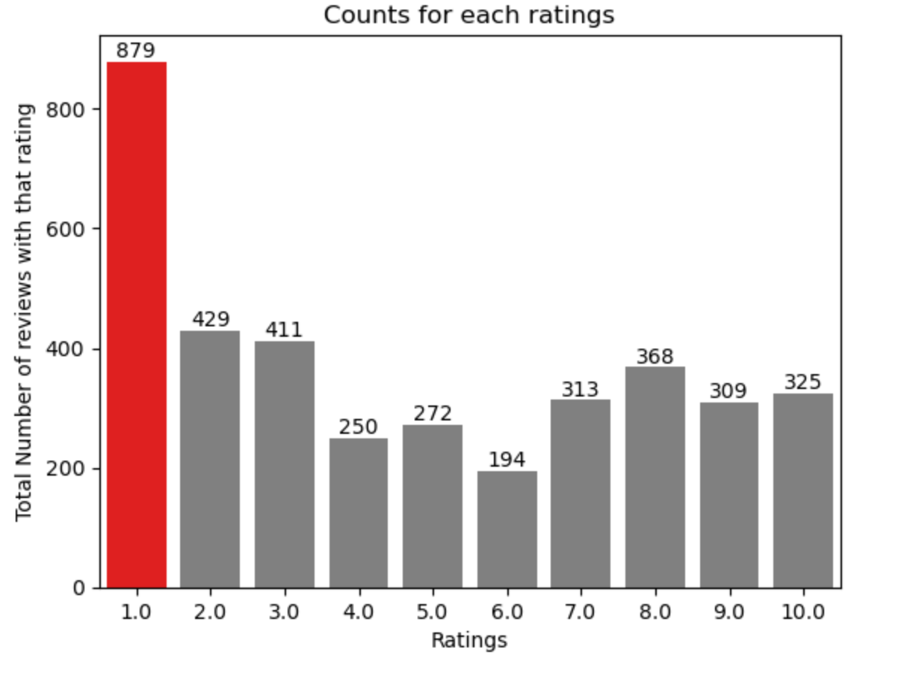

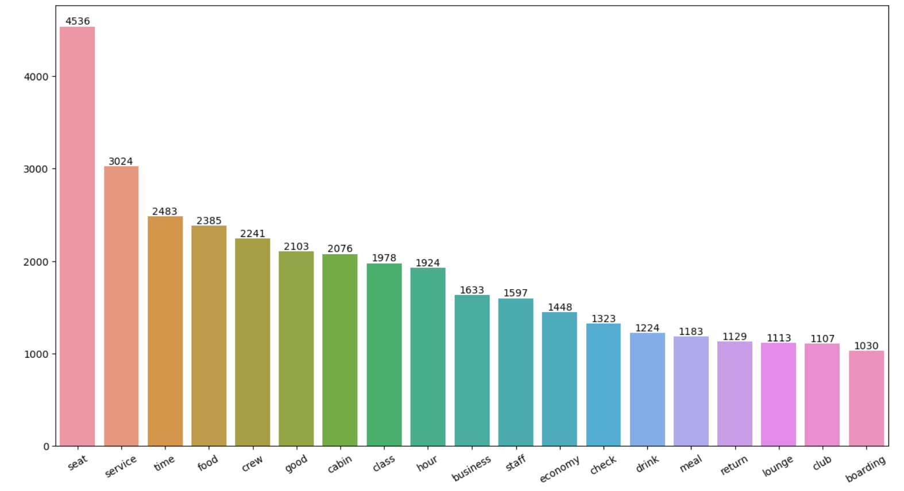
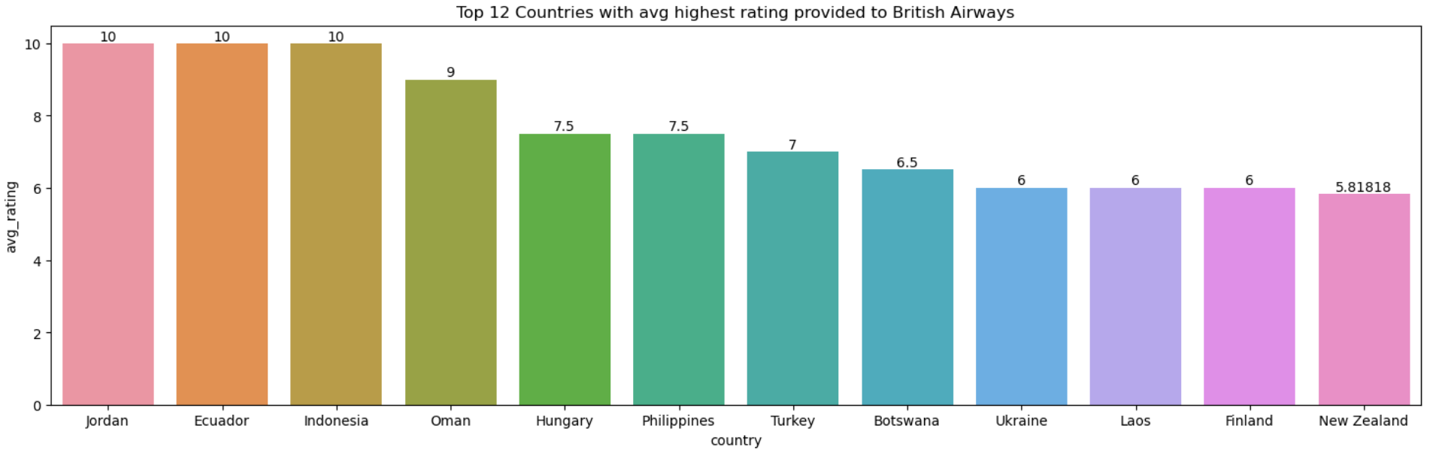

Statistics
When it comes to reviews, the majority of customers provided ratings between one and two instead of seven to ten.
By comparing all the graphs, we can conclude that most of the customers were satisfied with the cabin crew's services, as indicated by the majority of reviews, all of which were favorable. However, the majority of the customers were seated in business class as instead of economy class. Thus, looking it up, we can say that British Airways should focus more on enhancing economy class seating, entertainment, and service, as well as primarily delaying flights, as the majority of passengers had complaints about that.
Reviews from various countries
73
Overall Rating 4.71 / 10
Total Number of reviews 3755

